Slide 1

Fair or Forgotten?
Forecasting and Evaluating 2024 Playing Time
Brett Cerenzio, Aidan Gurvitch, Danielle Napierski, Zach Silverstein, and Dylan Stafeil
2025 Cincinnati Reds
Baseball Analytics Hackathon

Slide 2
Objective:
Predict Total Playing Time Players Will Receive in 2024
Batters
Plate Appearances
Pitchers
Batters
Faced
Using 2021-2023 Baseball Savant and Lahman Data
Notes:
Dylan

Slide 3
Filtering
Players
Notes:
Dylan

Slide 4


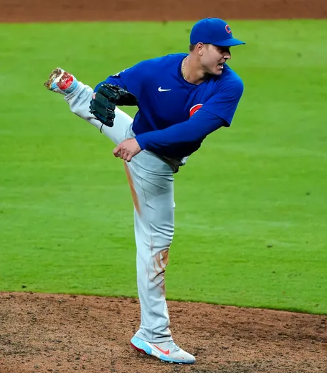
Batters
Filtering the Dataset
Remove Pitchers from PA & Batters from BF Datasets
Pitchers aren’t signed to hit and batters aren’t signed to pitch (minus Ohtani), helps reduce noise in the data
Pitchers from PA
Batters from BF
Check players who appear in BF data and has <10 PAs in 2022 and 2023
Universal DH implemented in 2022
Check players who appear in PA data and has <50 BFs across 2021-2023
This is AFTER pitchers are removed
Notes:
Dylan

Slide 5
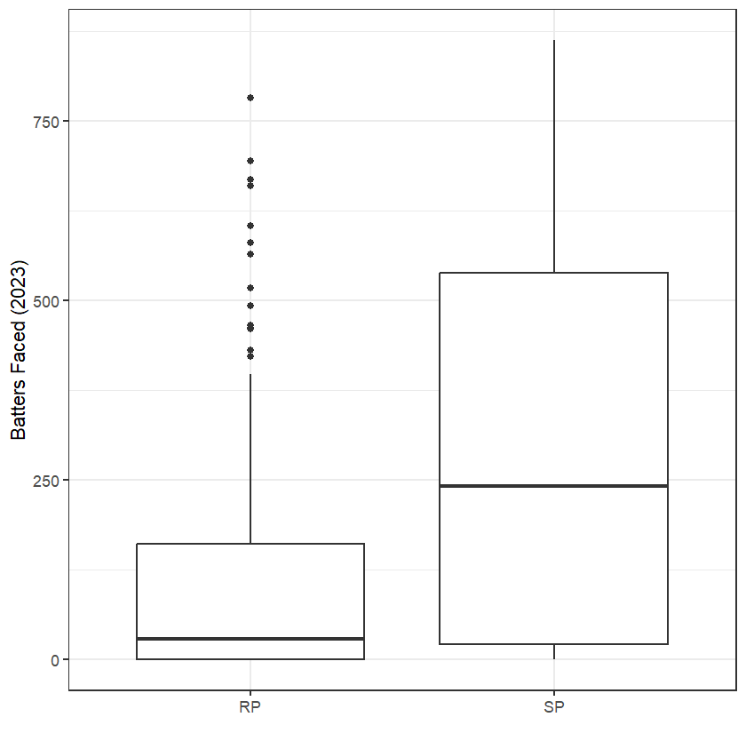
SPs Versus RPs
Starting Pitchers Vs Relief Pitchers
Differentiation
Number of Appearances
Based on Each Role
0.15 * (# 2021 Appearances) +
0.85 * (# 2022 Appearances)
Notes:
Danielle

Slide 6
Methodology
Notes:
Danielle

Slide 7
Position Players
Position Players
Workload
PA in Previous 2 Seasons
Lineup + Batter Position
Second Half PA
Games Started After Debut
Rookies
PA Per Game
Experience
Debut Month (Rookies) and Year
Age
Performance
Avg and 90th % EV
Total Bases, OBP, SLG
Fielding/Framing RV
Other Count/Rate Stats
Notes:
Danielle

Slide 8
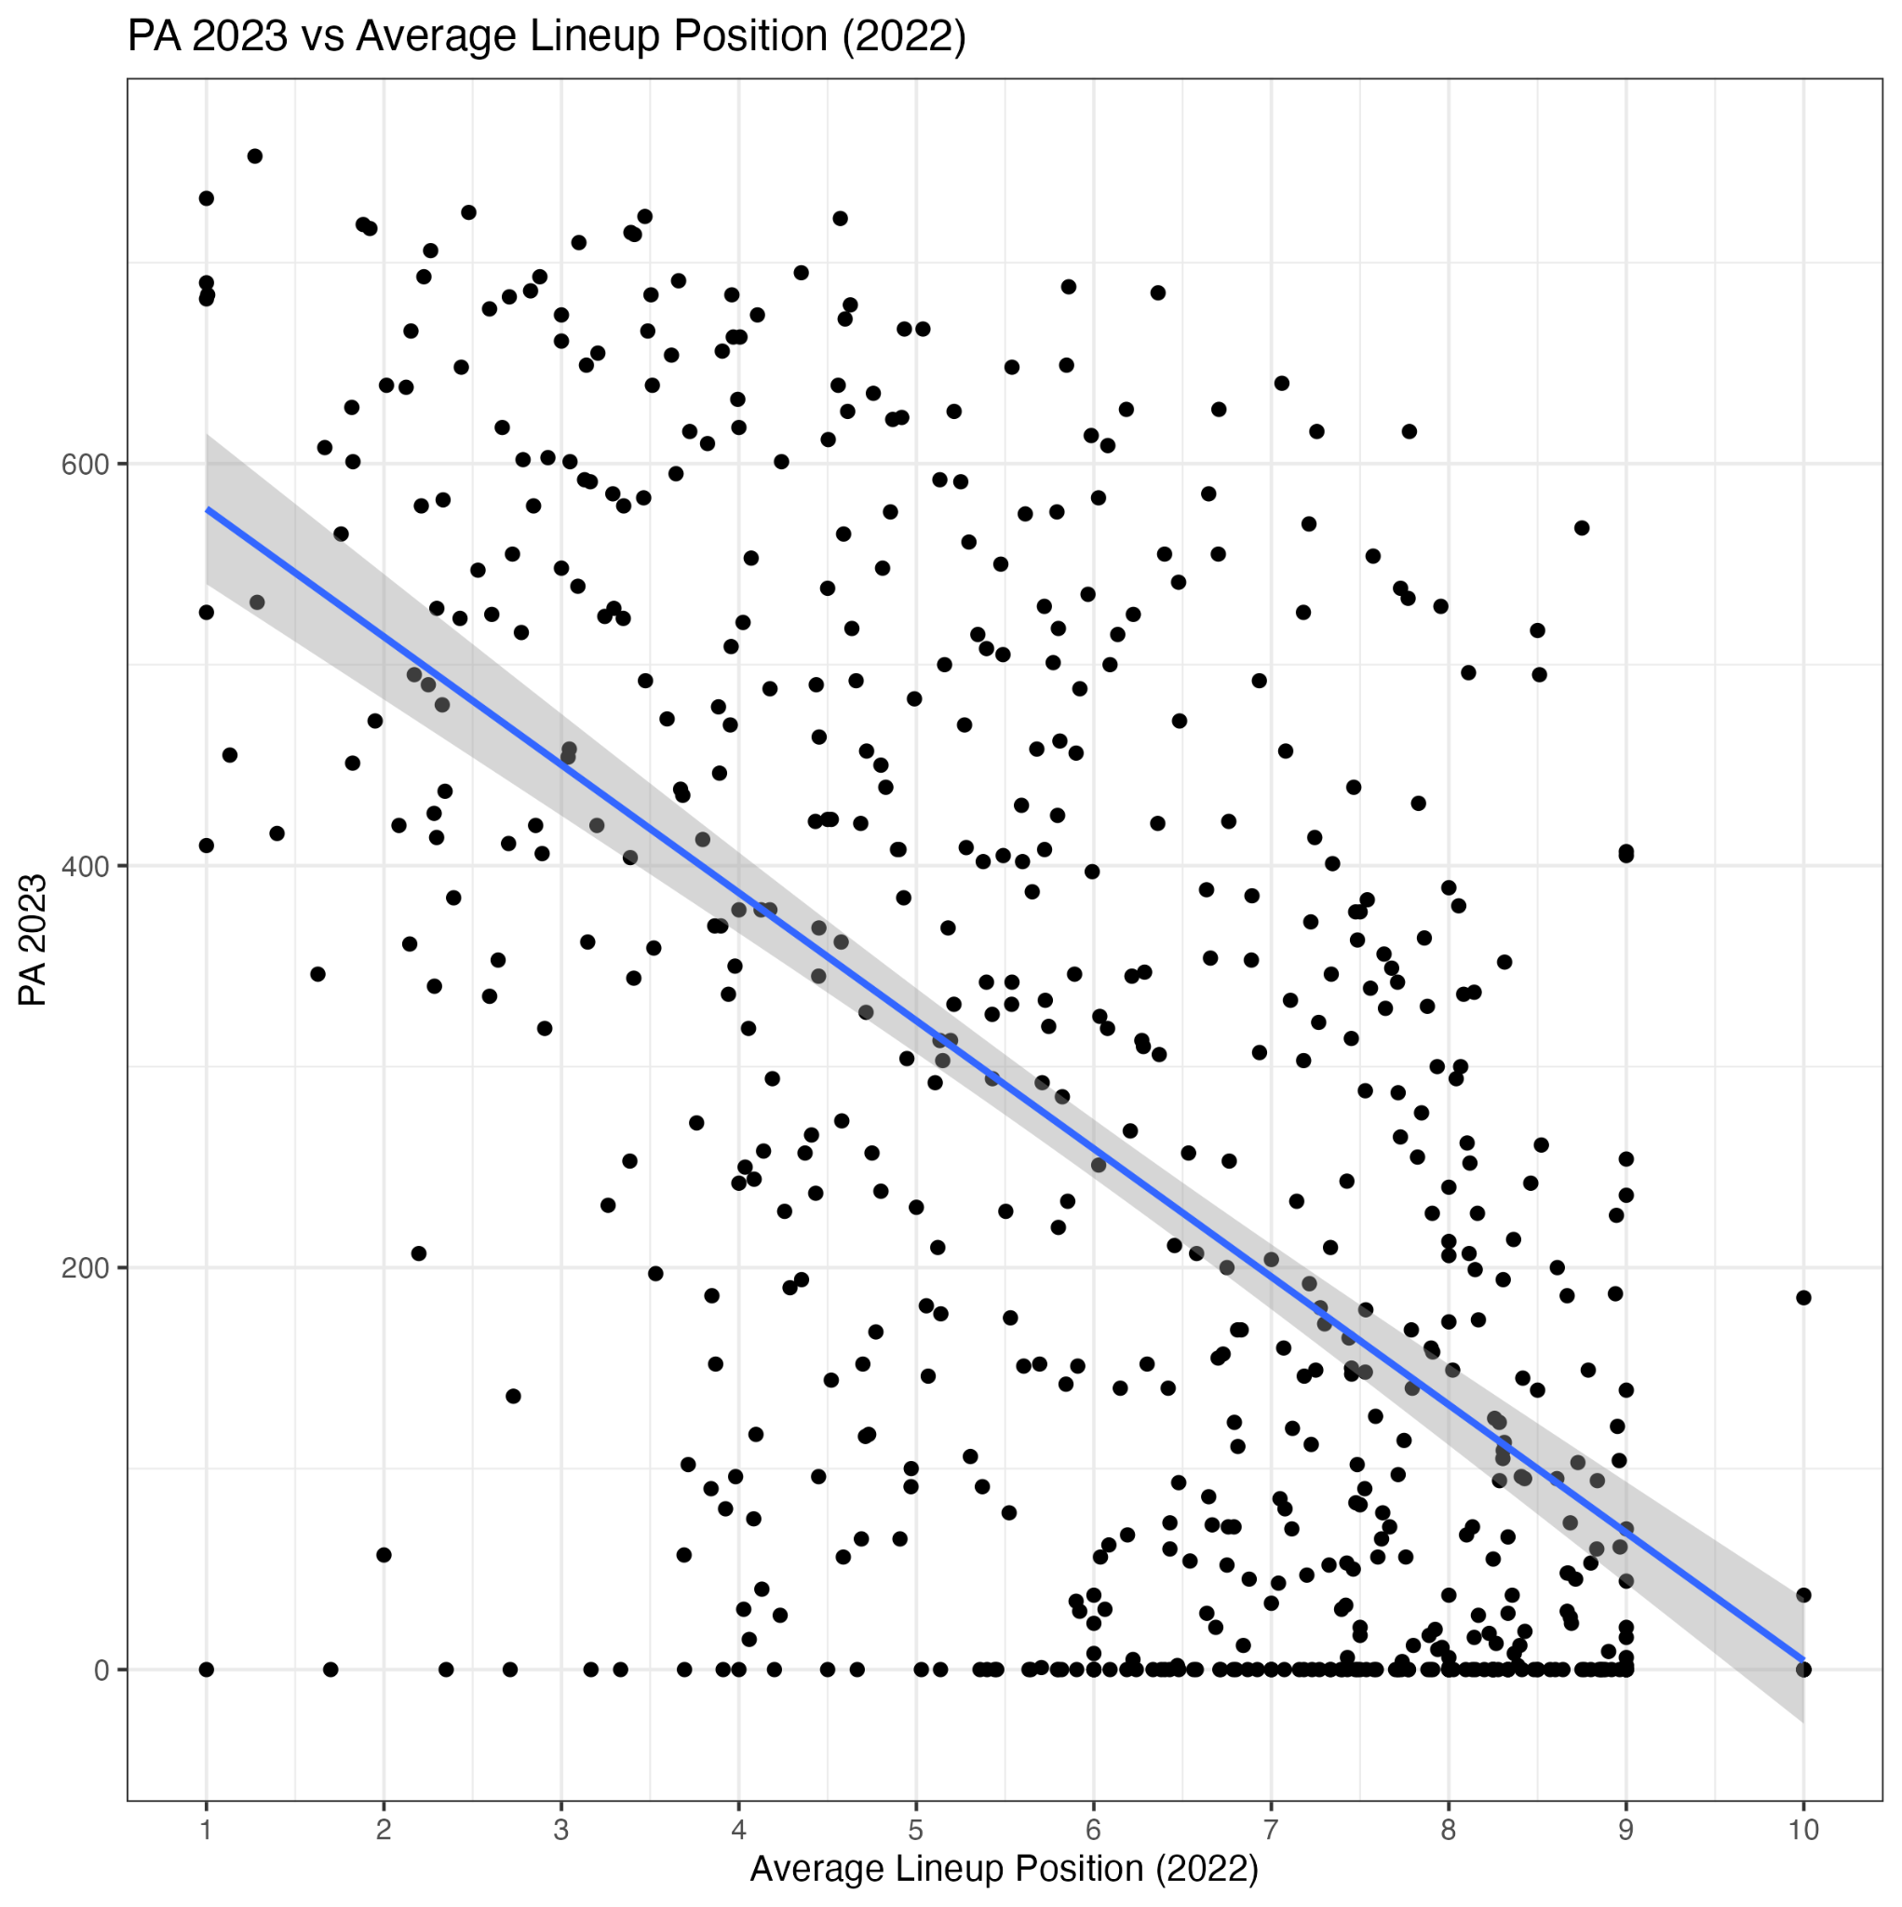
Lineup Position
Pitchers
Found the Average Batter Position in the Starting Lineup Across all 3 Years
Players who Didn’t Start a Game in a Given Year Were Assigned 10 in the Lineup Position
Players Batting Earlier in the Lineup Tend to Receive More Playing Time
Notes:
Aidan

Slide 9
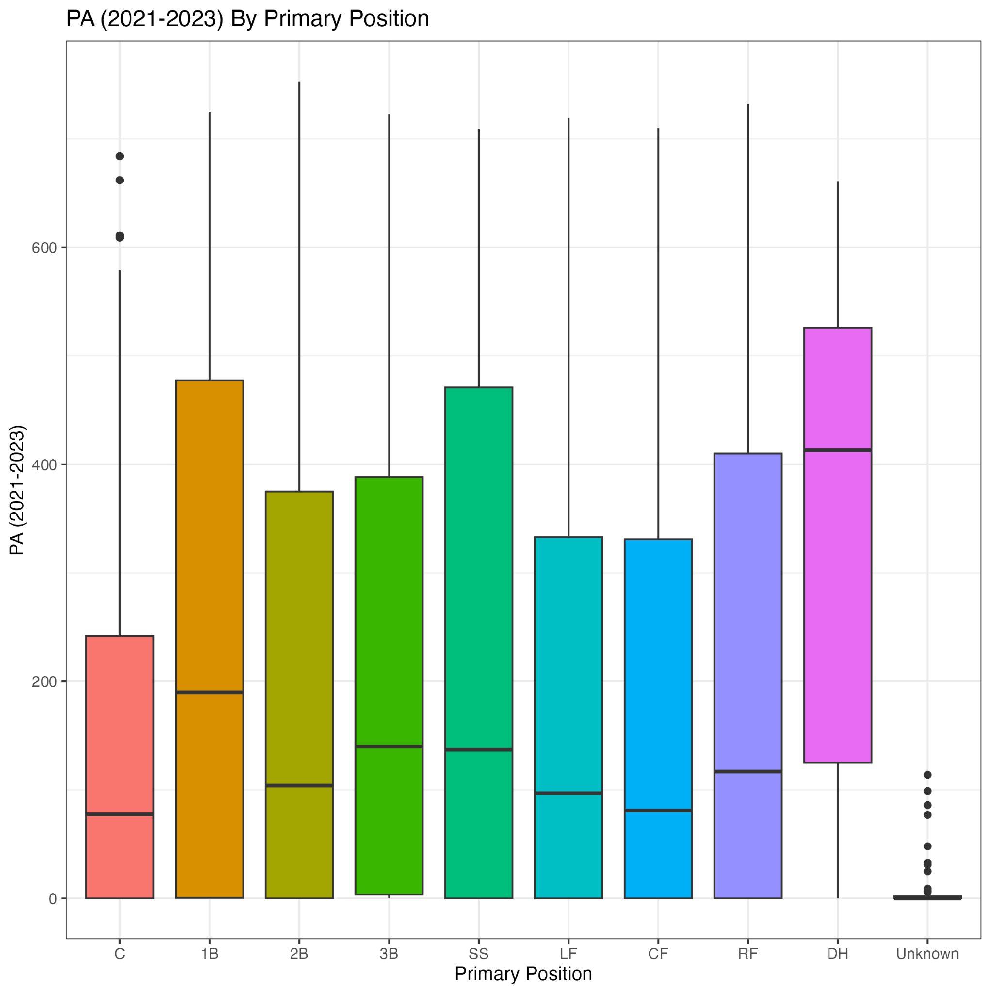
Batter Fielding Positions
Pitchers
Identified Primary Position by Where They Started the Most Over 2021-2023
Catchers Typically see Less Playing Time
1B and DHs get a lot More Playing Time Relative to Other Positions
“Unknown” Represents Players That Never Started in the Field
Notes:
Aidan

Slide 10
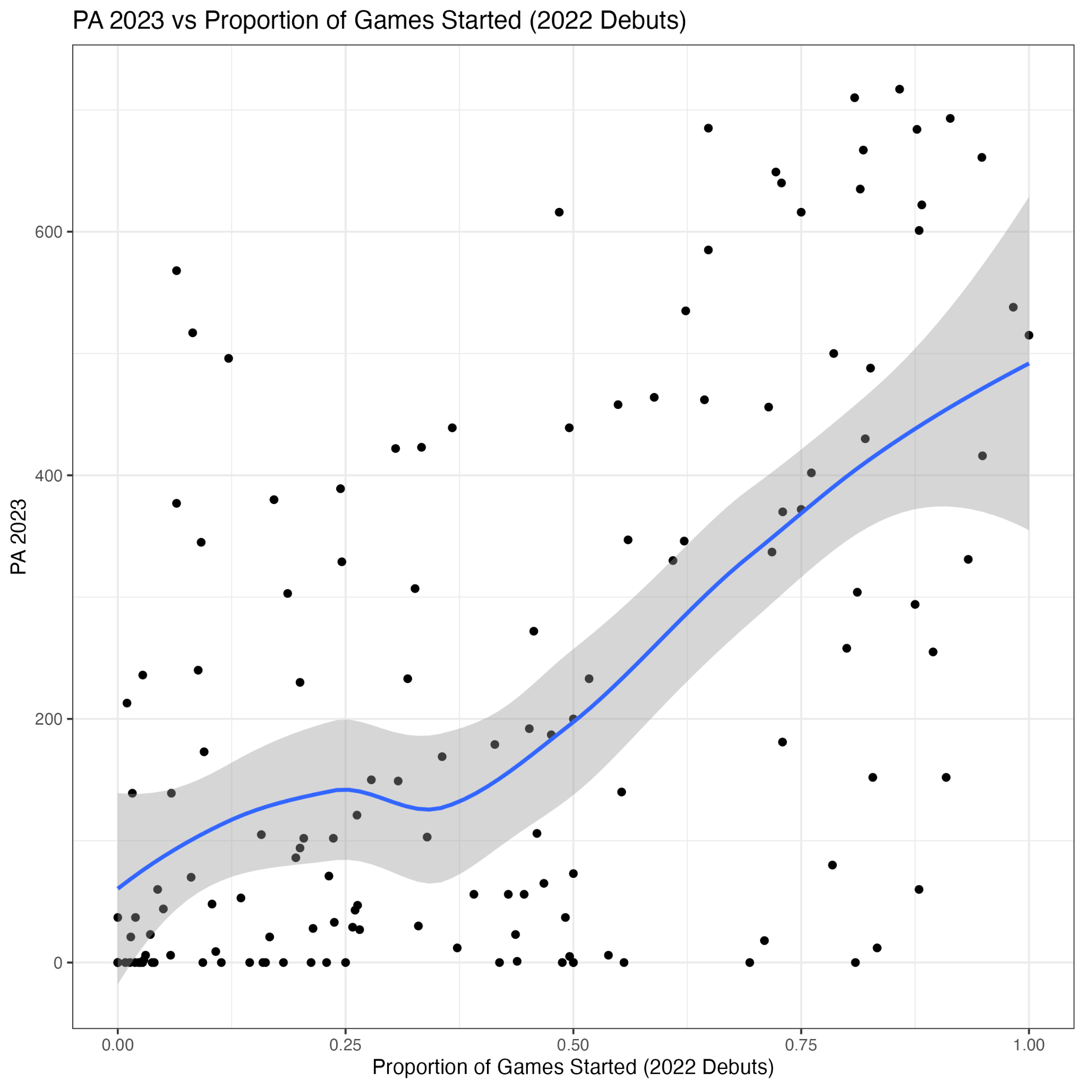
Pitchers
Proportion of Games Started (Debuts)
Identified Number of Games Remaining on a Team’s Schedule and Number of Games a Player has Started Using Debut Date
If a Rookie Starts Roughly 35% of Games, Their Playing Time Should Increase
Notes:
Aidan

Slide 11

Pitchers
Pitchers
Workload
Pitches per PA
BF in Second Half of Season
BF Splits
BF In Past 2 Seasons
Pitches per Appearance
BF per Appearance
Avg. Times Through Order
Performance
90th Percentile Fastball Velocity
Strikeouts and K%
Other Count and Rate Statistics
SP: Number in Rotation on Opening Day
RP: Number of 9th Inning Appearances
Notes:
Zach
Identified Numerous Characteristics that may impact a player’s playing time
Pitchers
Pitches Per Appearance
BF Per Appearance
Times Through the Order
Pitches per PA
Second half BF
BF Splits (# of BF vs LHH vs # of BF vs RHH (Absolute Difference)
90th percentile fastball velocity
Other Counting & Rate Stats
IP, ERA, FIP, Ks, K%, BBs, HR, HR%, Pitches Thrown, Pitcher RV, etc.
SP
Number in Rotation on Opening Day
RP
Number of 9th inning appearances

Slide 12
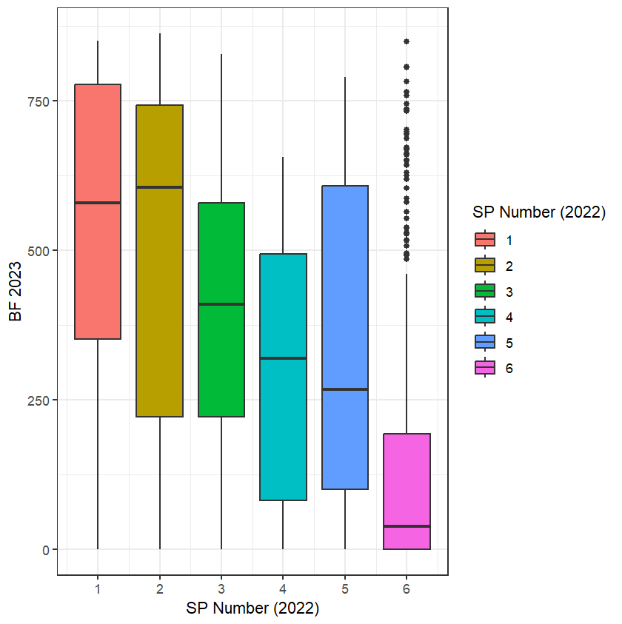
Number in Starting Rotation (Opening Day)
Pitchers
Opening Day Starters Face the Most Batters on Average Throughout the Season
Inverse Relationship Between Rotation Number and Workload
Notes:
Zach

Slide 13
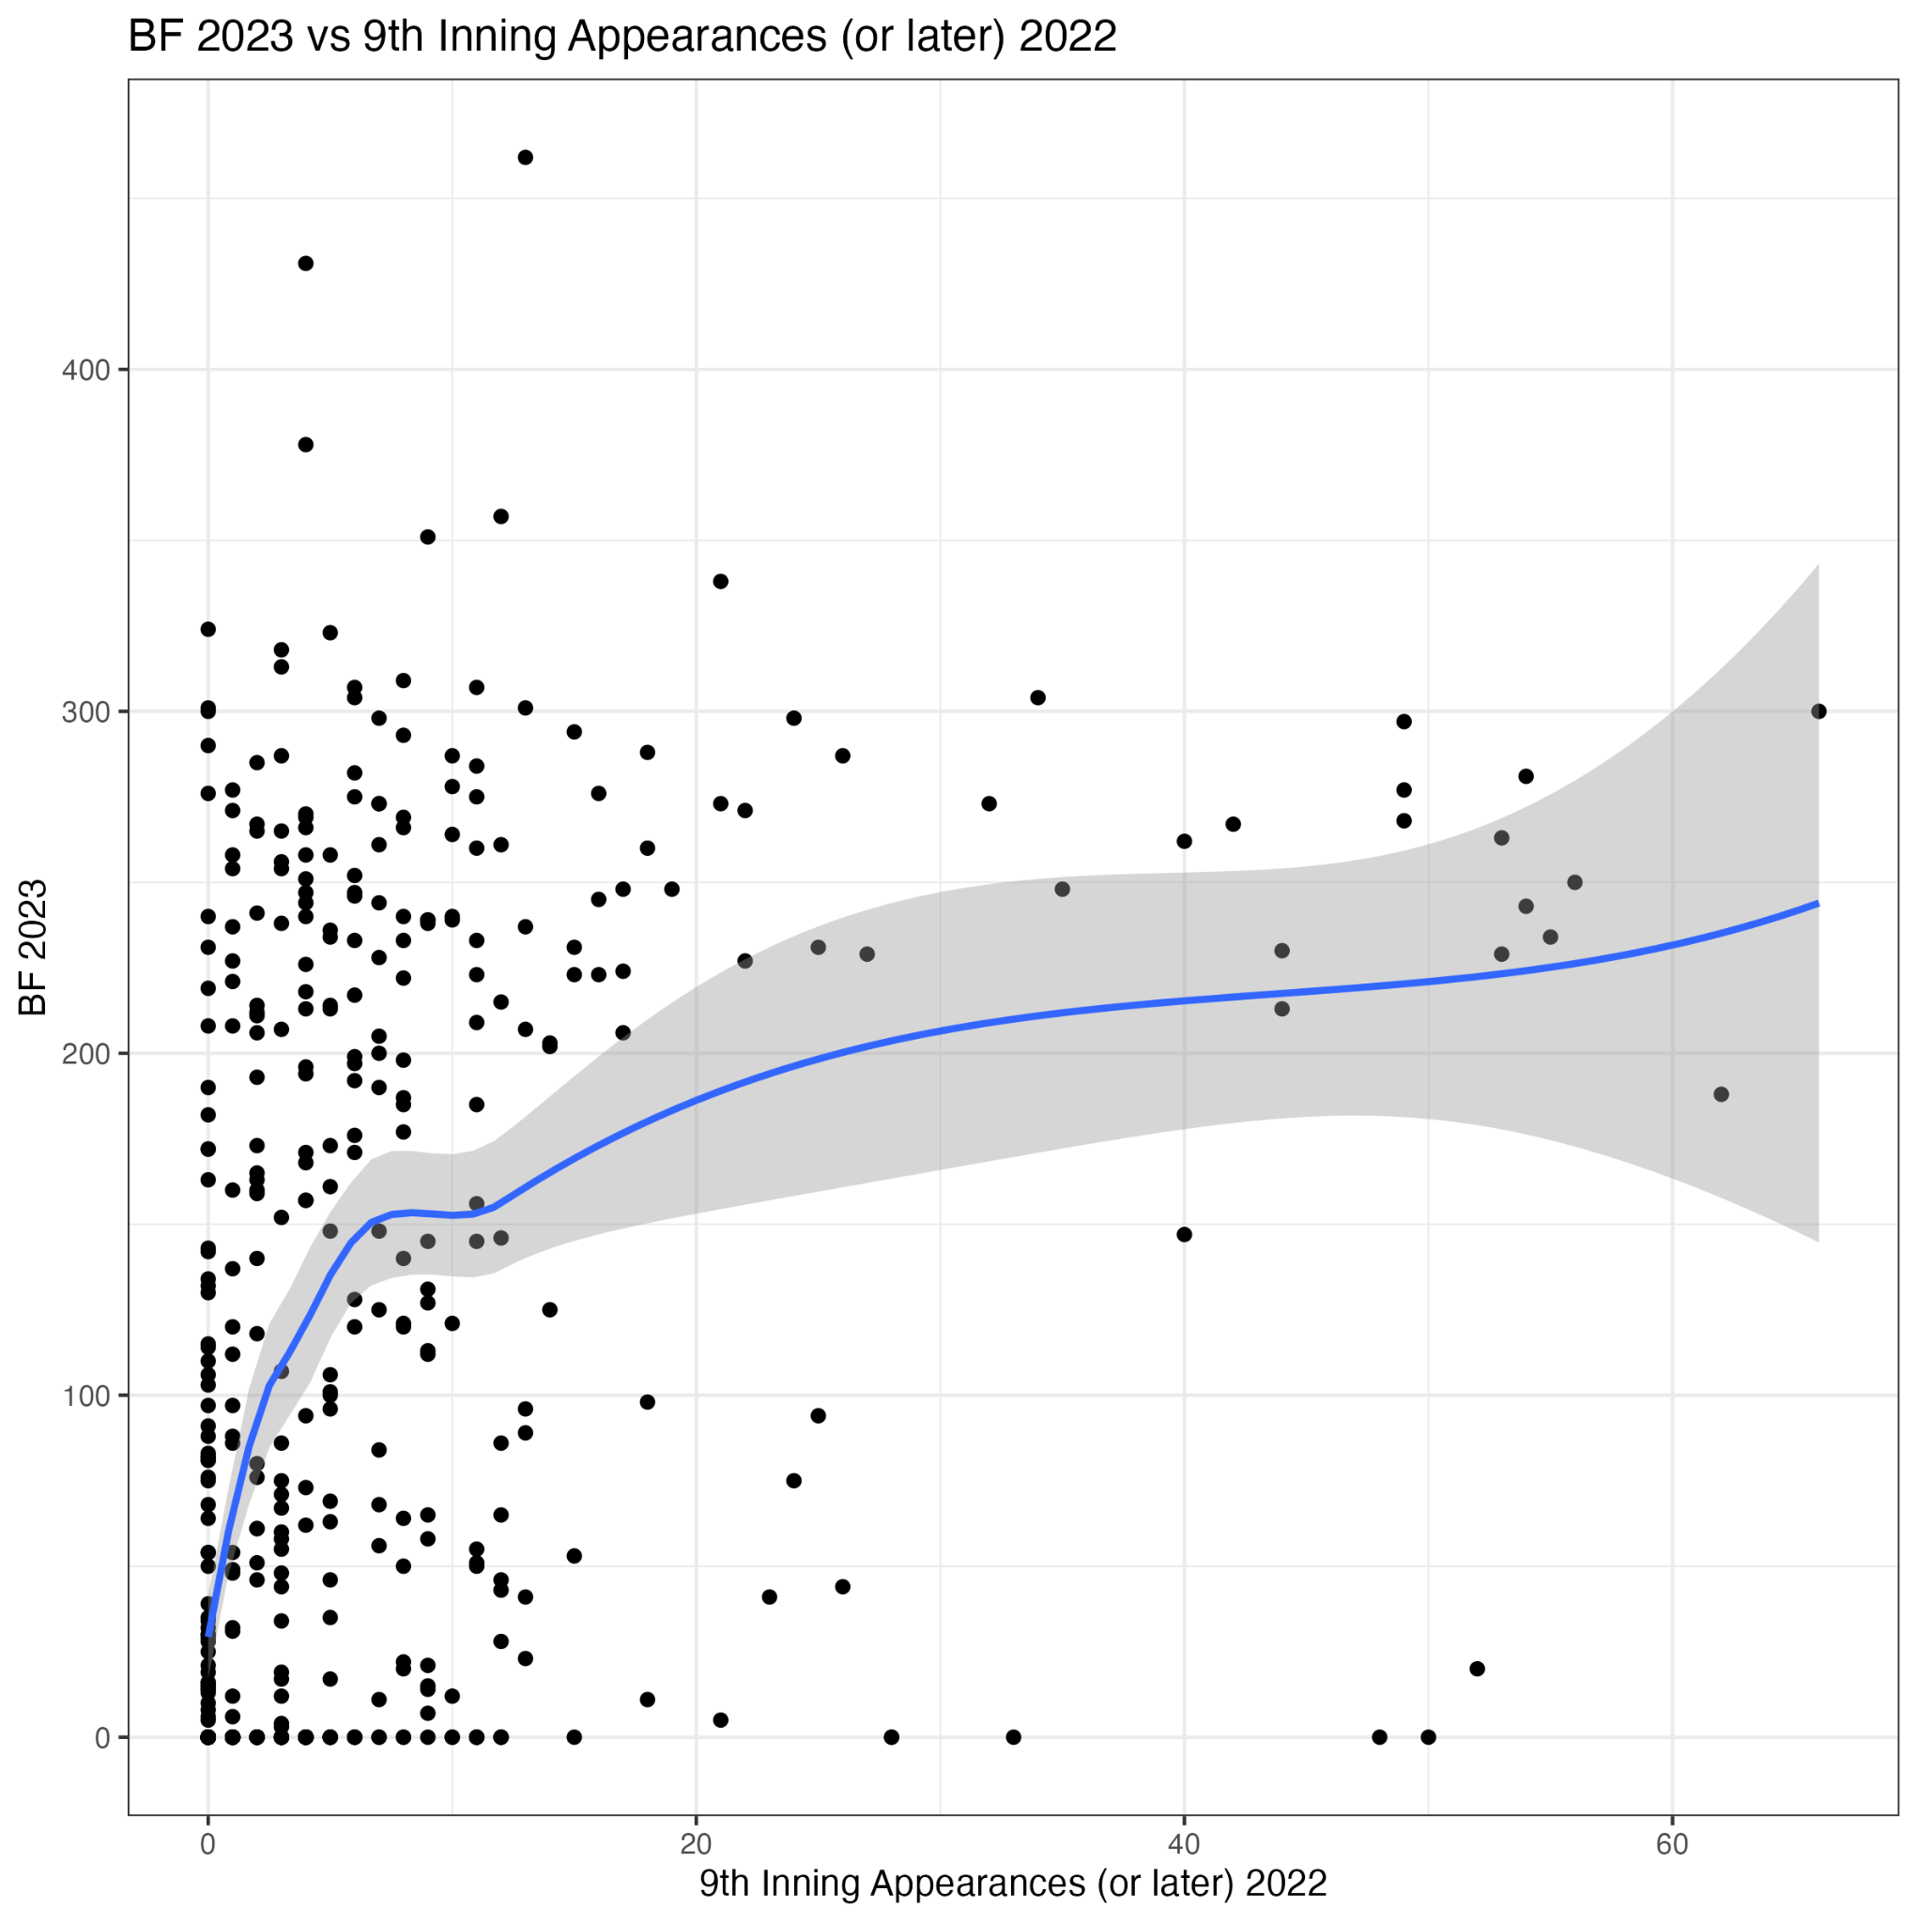
Number of 9th Inning Appearances
Pitchers
High Leverage Relievers are Going to Pitch in the 9th Often
Logarithmic Relationship Between 9th Inning Appearances and BF the Following Season
Notes:
Zach

Slide 14
NA Imputation
NA Imputation
K%: 10th Quantile
Rate Stats:
10th Percentile Outcome
FIP: 90th Quantile
Lack of PAs in a Season is Most Likely due to an Injury or Poor Ability
Notes:
Brett

Slide 15
Clustering
Analysis
Notes:
Danielle
Identifying playing consistency throughout the season (monthly playing time) and evaluate its impact on future playing time
Provide insight into whether a player got less PA/BF because he was benched or if it was because he was injured

Slide 16
Why This Approach?
Identify Playing Consistency Throughout the Season (Monthly Playing Time) and Evaluating its Impact on Future Playing Time
Insights to Whether a Player got Less PA/BF due to Being Benched or Injured
These Metrics are Only Valuable When Used Together, Rather Than Individually
Notes:
Danielle

Slide 17
K-Means Clustering
Batters and Relief Pitchers
Monthly Playing
Time
Proportion of Total/Season Playing Time That Occurred in Each Month
Whether the Player was a Rookie
*all for the prior 2 seasons
Batters: 18 Clusters
RPs: 14 Clusters
Notes:
Danielle
Variables Clustered On:
Monthly Playing Time Throughout Previous 2 Seasons
Proportion of Total/Seasonal Playing Time That Occurred in Each Month Throughout Previous 2 Seasons
Whether the Player was a Rookie in the Past 2 Years (as separate variables)

Slide 18
K-Means Clustering
Starting Pitchers
Algorithm 1
Algorithm 2
Monthly Playing Time Throughout the Past 2 Seasons
Monthly Proportion of Total Playing Time Throughout the Past Season
And Whether a Rookie in 2021 or 2022 (as separate variables)
Algorithm 1: 7 Clusters
Algorithm 2: 6 Clusters
Notes:
SP
2 Separate KMeans Clusters:
Clustering algorithm 1: Monthly Playing throughout the past 2 years and whether they were a rookie in 2021 or 2022 (2 separate variables)
Clustering algorithm 2: Proportion of total/seasonal playing time that occurred in each month throughout the past season, and whether they were a rookie in the past 2 years (2 separate variables)
Main Concern: Looking for potential injuries in the 2022 season
Used 2 algorithms due to the limited number of observations in the SP dataset
Too much variation to combine all the variables together
Clustering algorithm 1: 7 Clusters
Clustering algorithm 2: 6 Clusters

Slide 19
Models

Slide 20
Finding the Right Fit
Finding the Right Fit
Model Construction
Removed players who debuted in 2023, didn’t play in past or current season, or didn’t exist in Lahman database
35 Fold CV
Limited Data, Model Was Efficient Despite Numerous Folds
BART
Applies Non-Parametric Approach to Bayesian Modeling
Less Prone to Overfitting, but Computationally Expensive and Limited Interpretability
XGBoost
Boosting Algorithm that Minimizes the Residuals
Efficient and High Performance, But Prone to Overfitting
Notes:
Note that we ended up using XGBoost outperformed BART in all 3 models
Brett

Slide 21
Weighting Player Characteristics
Weighting Characteristics
Individualized Weights Were Created Based on Player Characteristics
Group 1
Group 2
Group 3
Group 4
100+ PA/150+ BF 2 Seasons Ago
Less Than 30 PA/50 BF in Past Season
(Weight 2)
100+ PA/150+ BF in Past Season
Less Than 30 PA/50 BF 2 Seasons Ago
NOT a Rookie
(Weight 3)
Rookies Who Debuted Before May
Assigned 2022 Stats
Rookies Who Debuted in May or June
Counting Stats Only
(Weight 4)
Group 5
Group 6
Group 7
Rookies Who Debuted in July or August
Counting Stats Only
(Weight 5)
Rookies Who Debuted in September or October
Counting Stats Only
(Weight 6)
All Other Players Who Don’t Meet Groups 1-6
(Weight 1)

Slide 22
Results

Slide 23
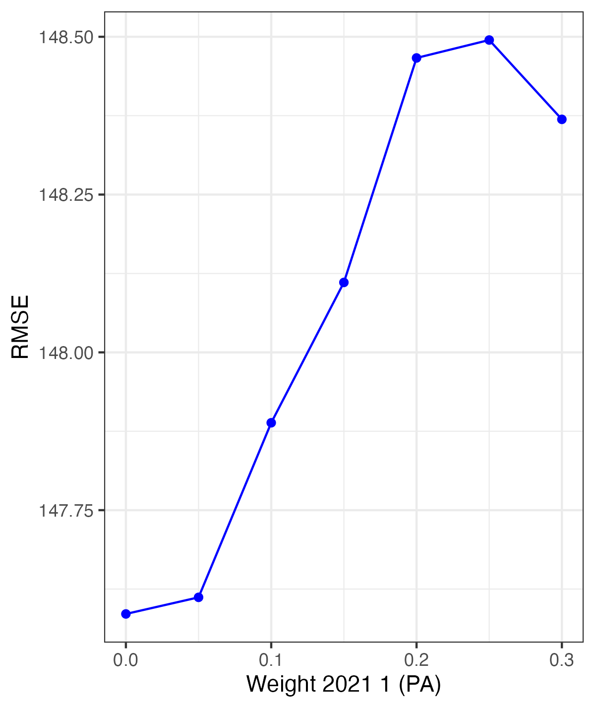
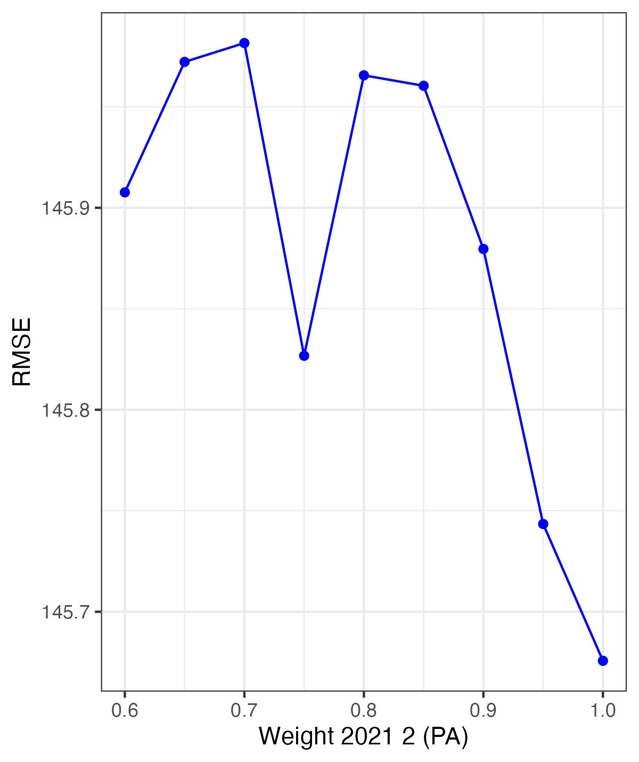
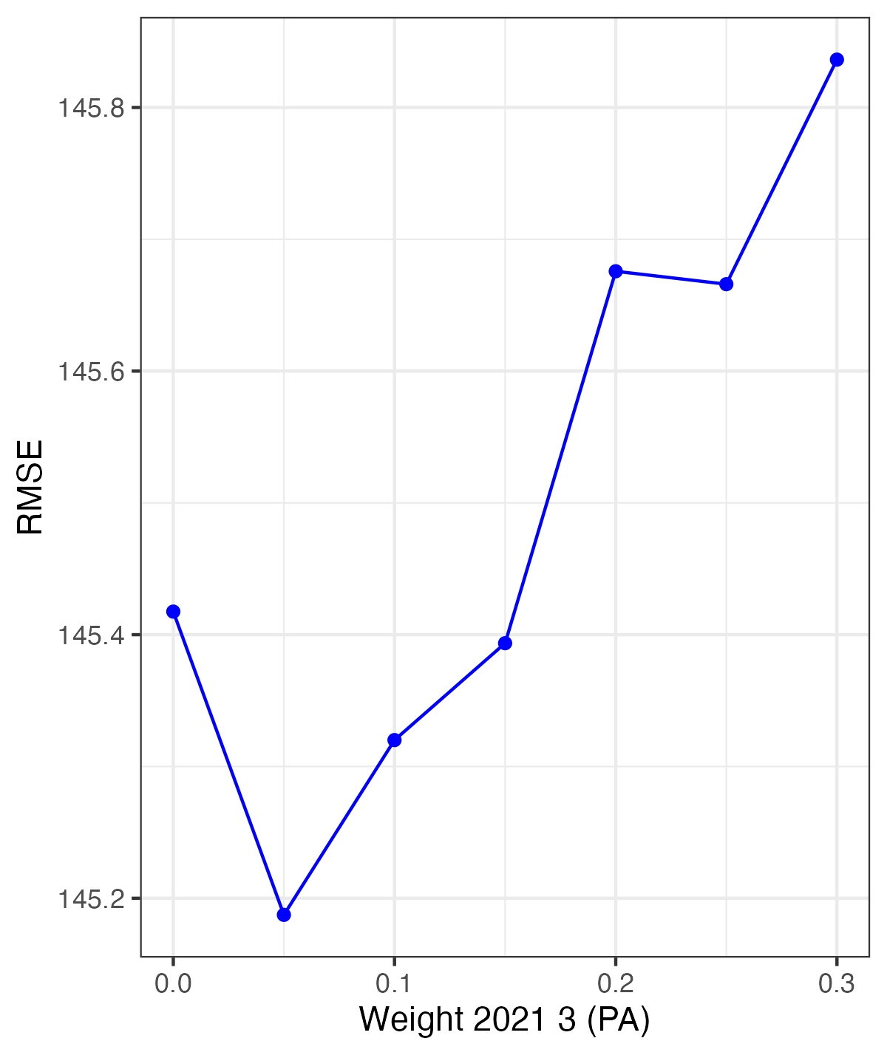
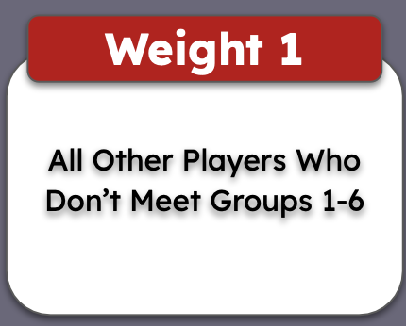
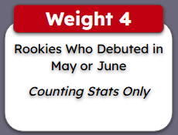
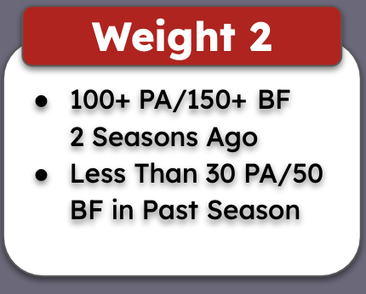
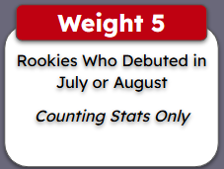
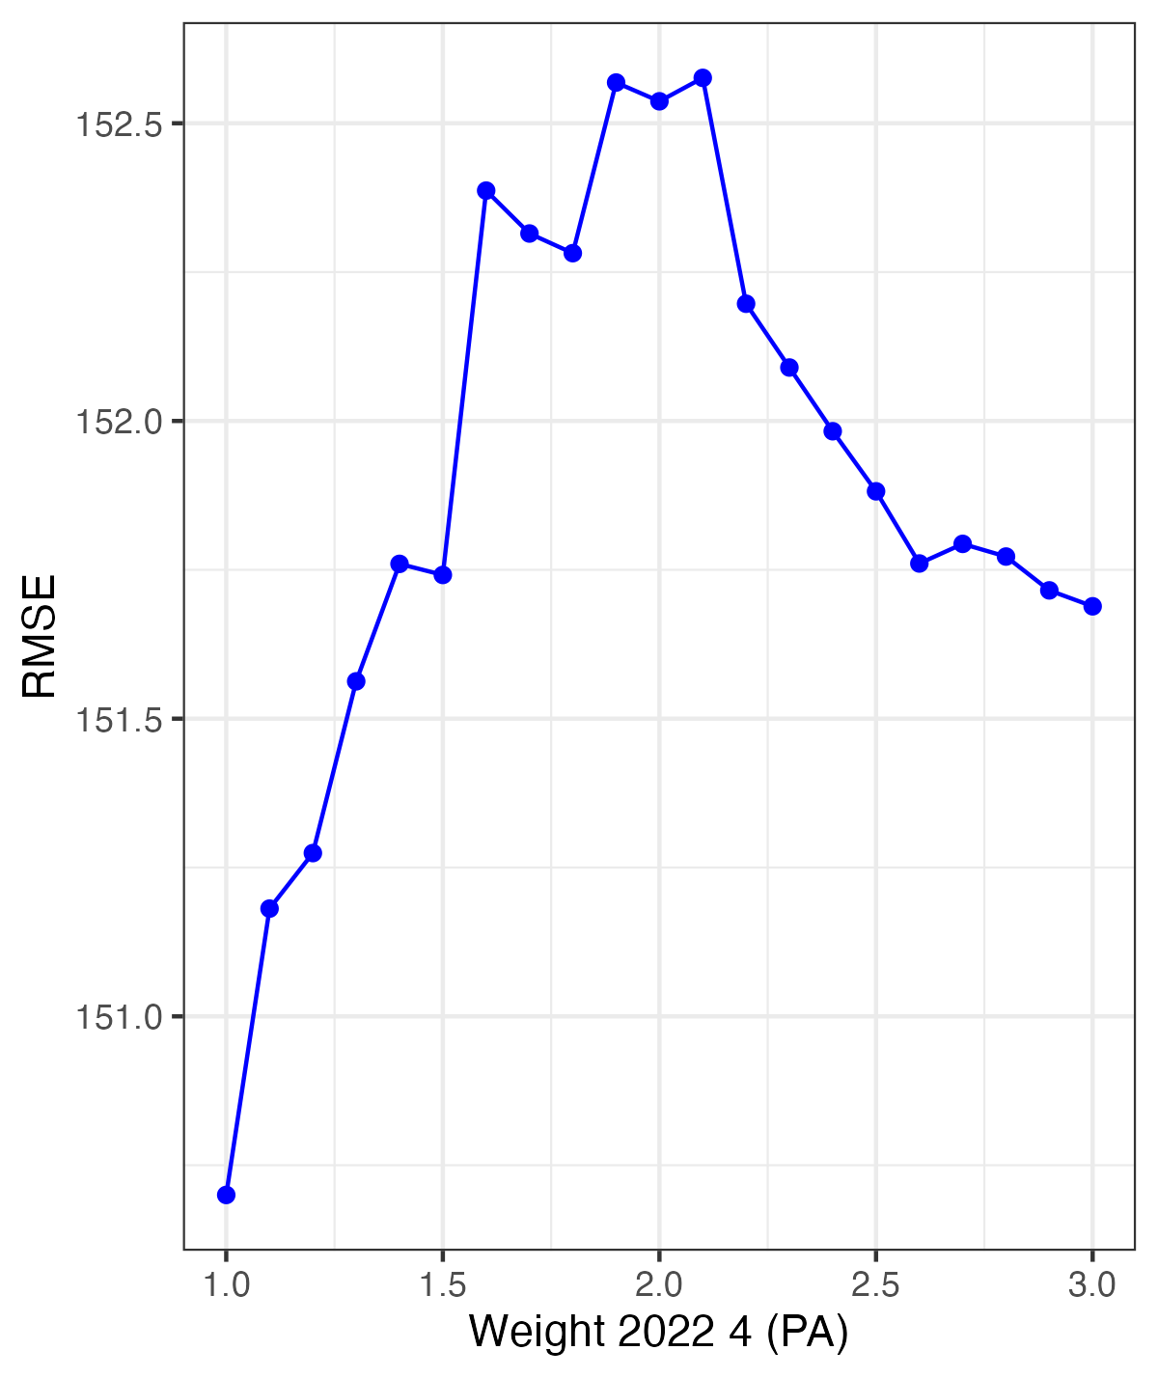
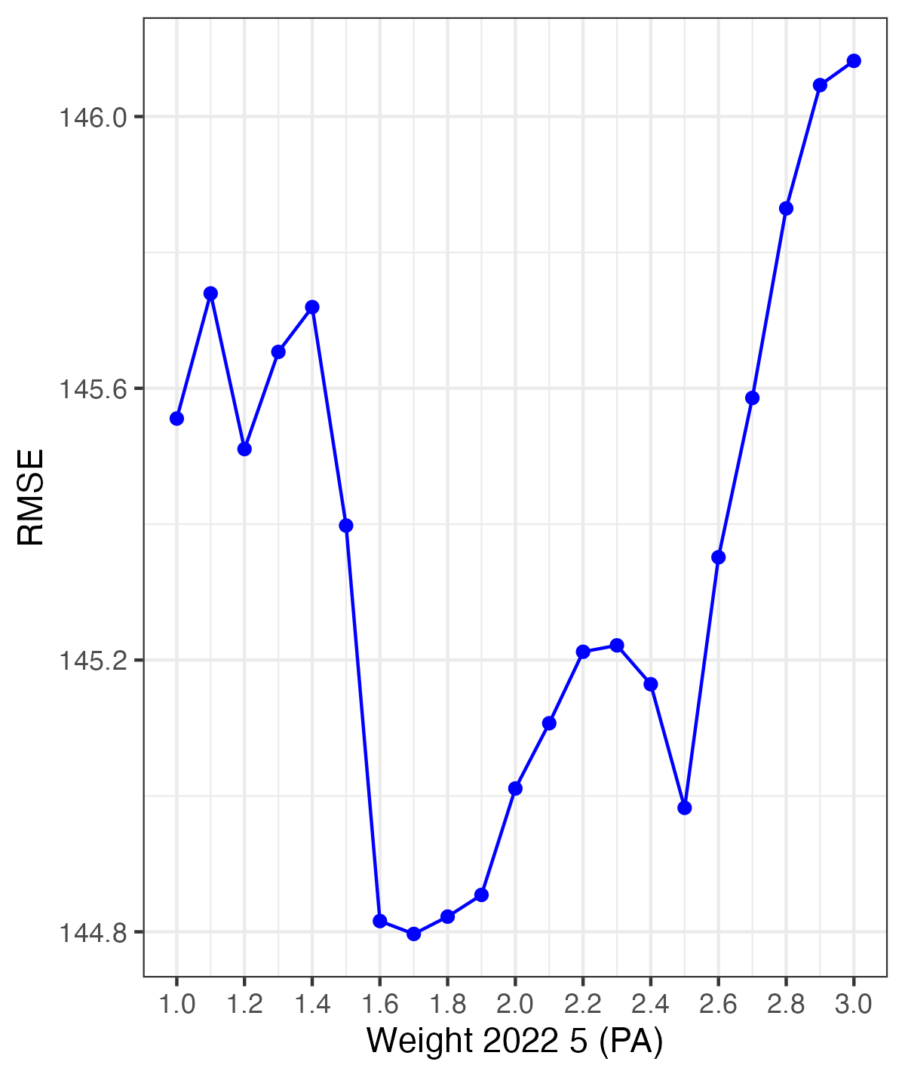
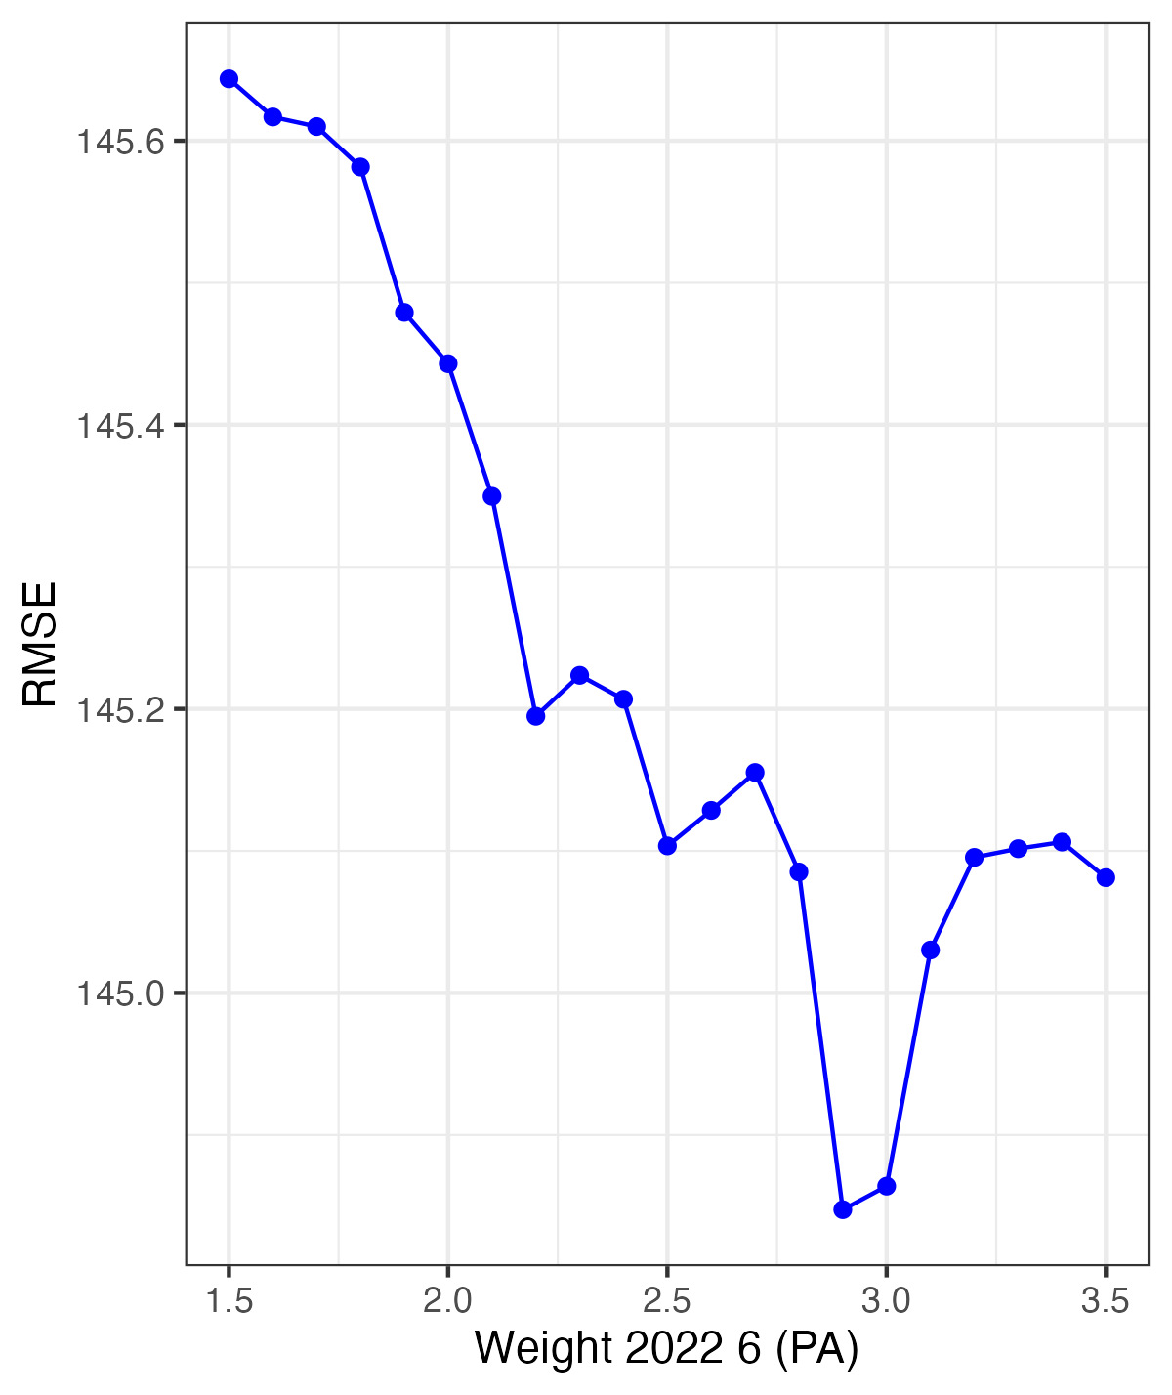
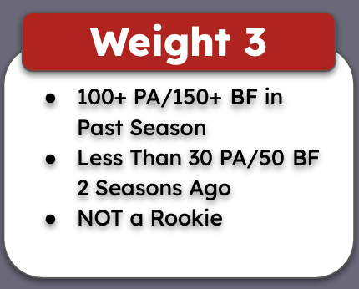
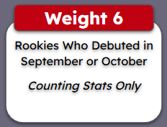
PA Weights
Pitchers
Notes:
Zach

Slide 24
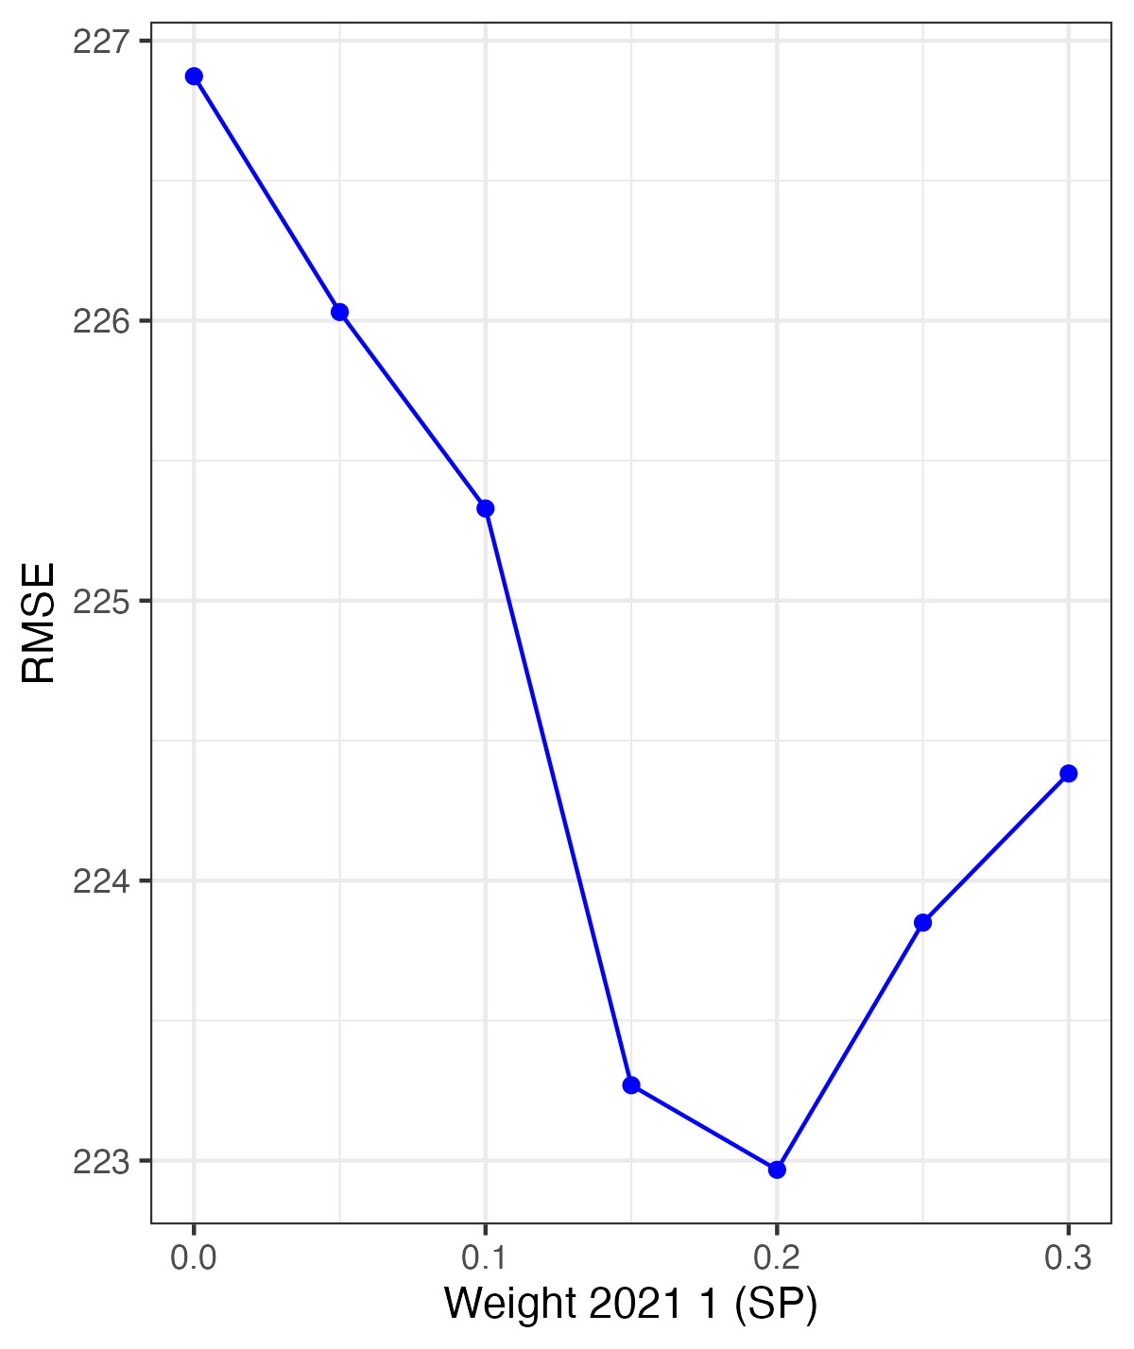
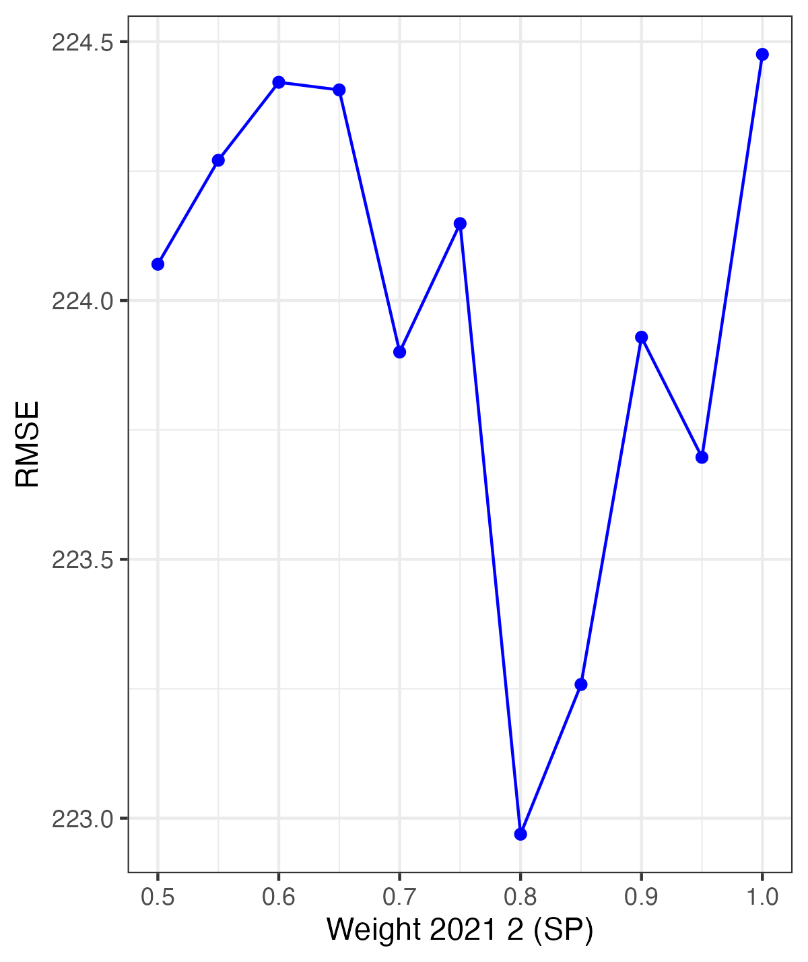
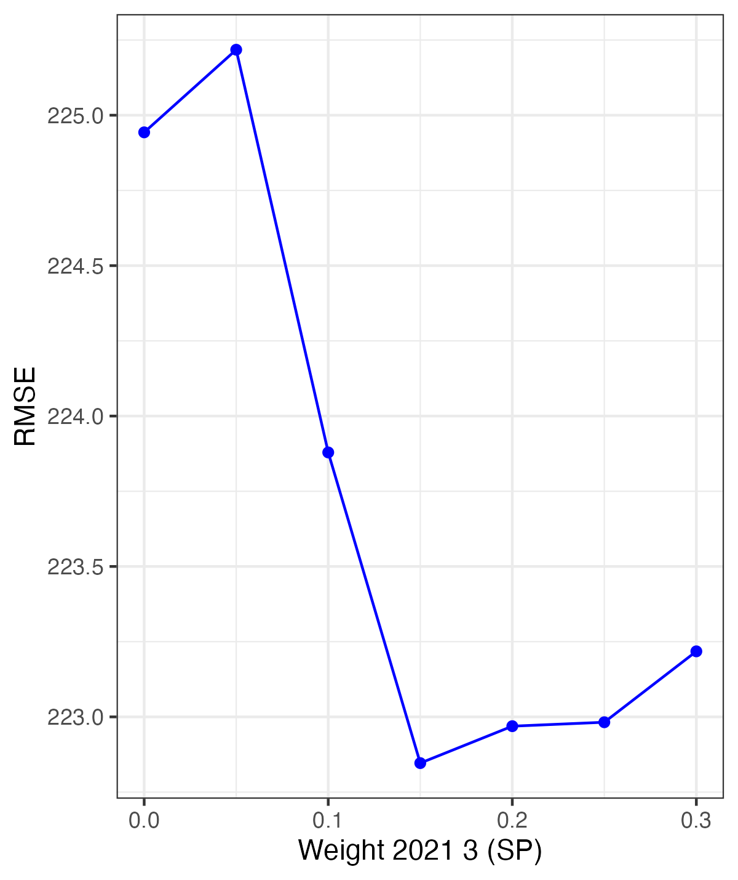
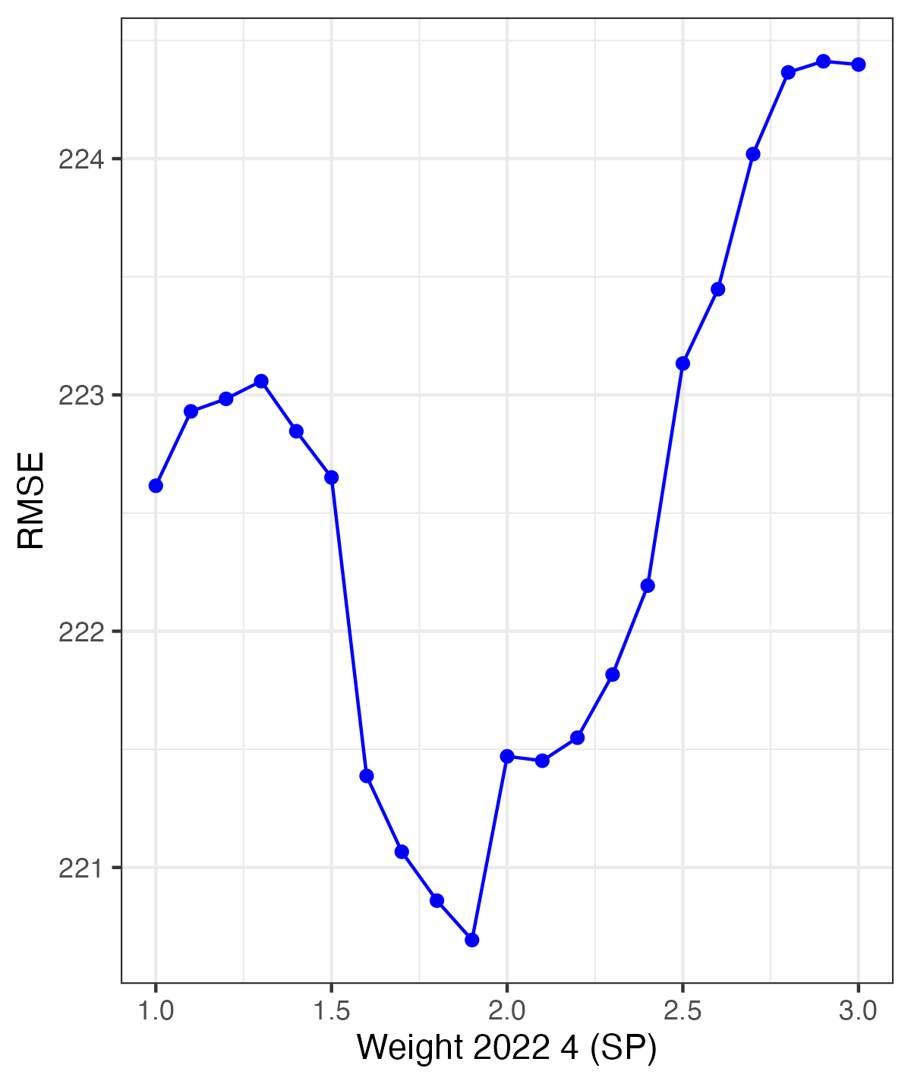
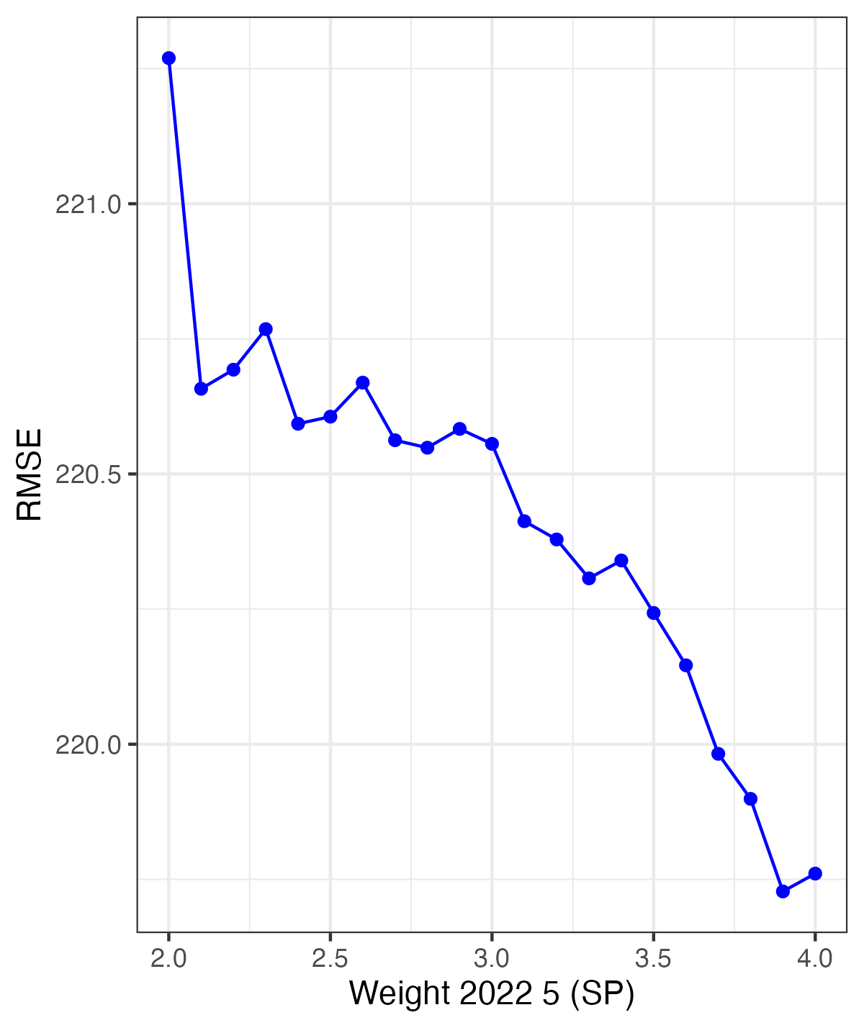
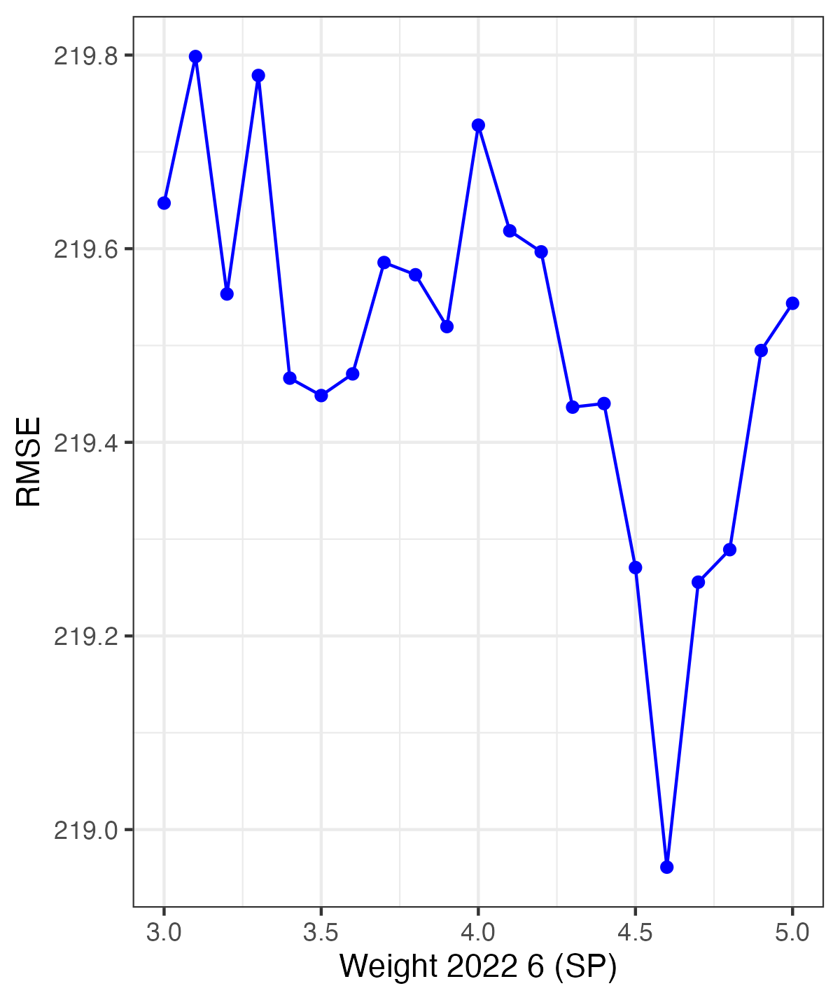
SP Weights
Pitchers
Notes:
Zach

Slide 25
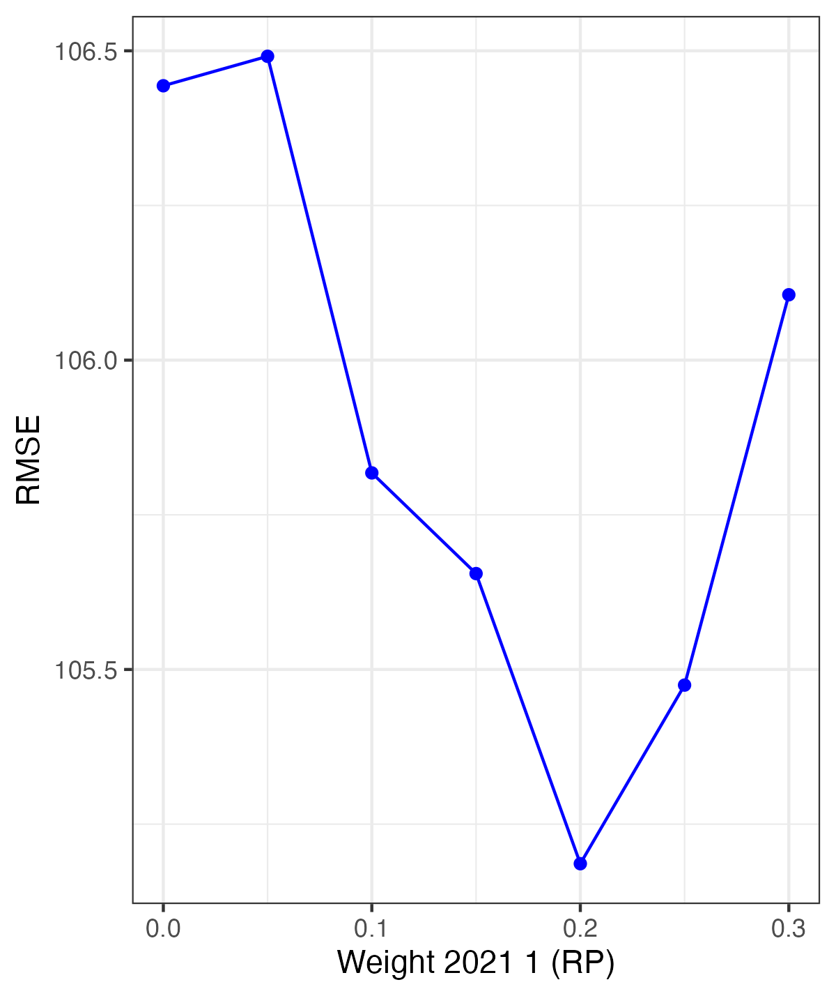
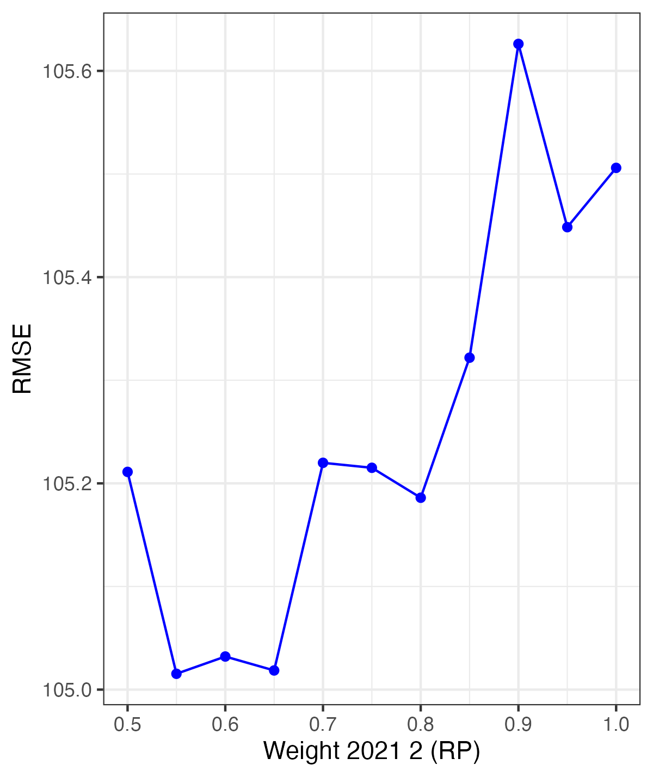
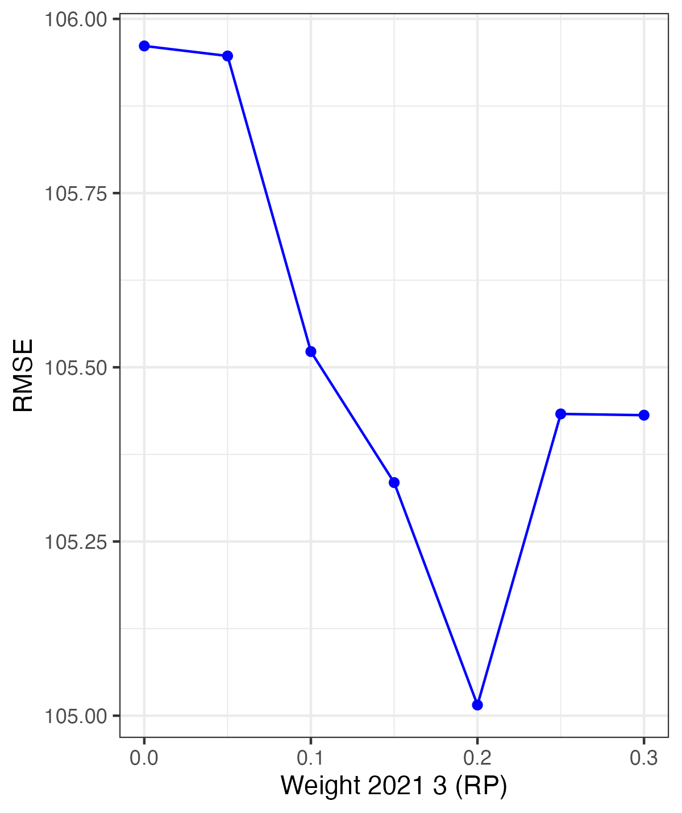
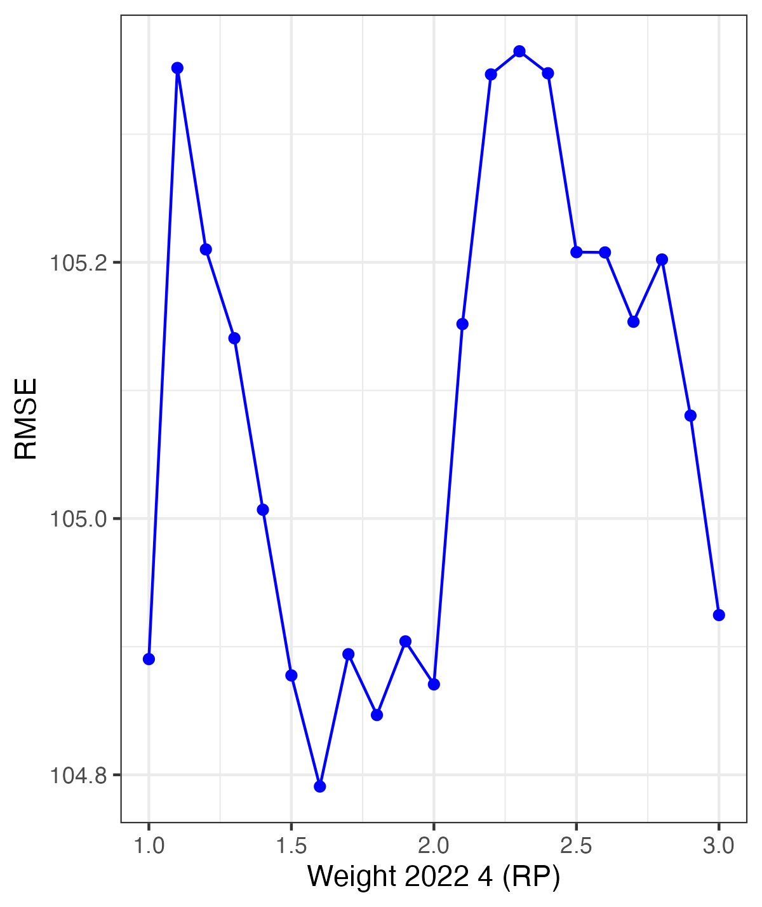
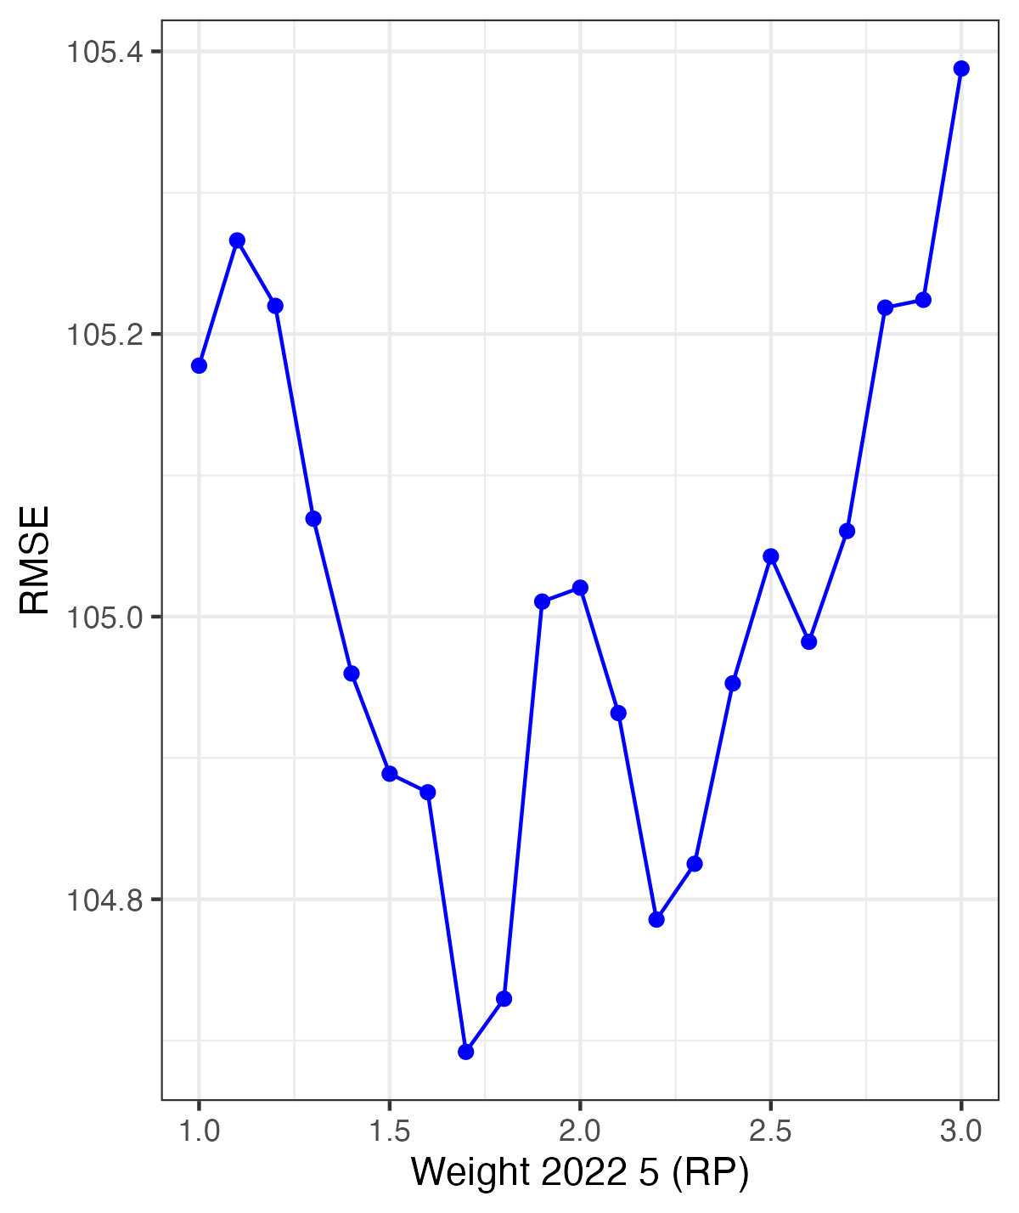
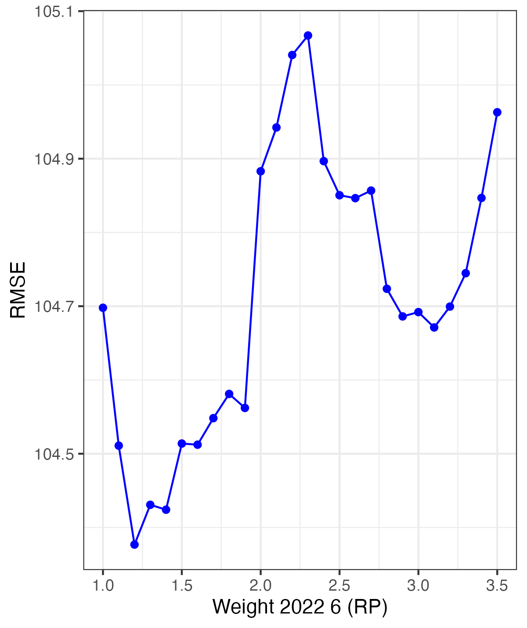
RP Weights
Pitchers
Notes:
Zach

Slide 26
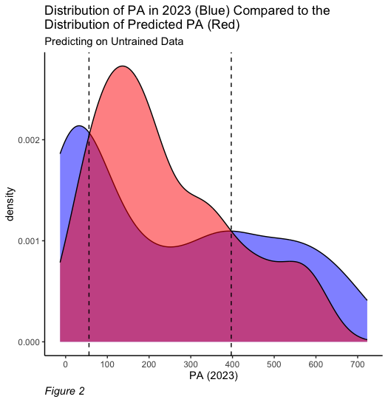
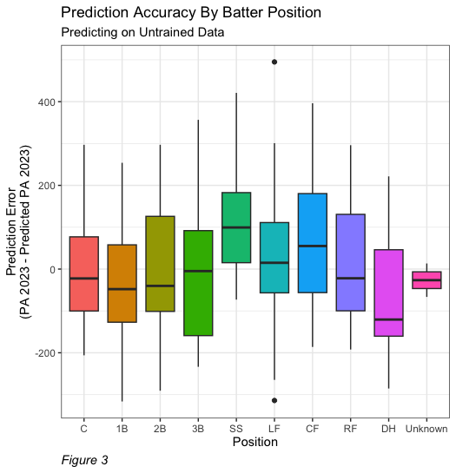
Batter Distribution ➞ RMSE: 144.3
Notes:
Aidan
Batter RMSE: 144.3
XGBoost Model
Overdispersion present in predictions
Severely over predicted on DHs
Model did well on Rookies (Both in 2021 & 2022)
Severely underpredicted SS and CF

Slide 27
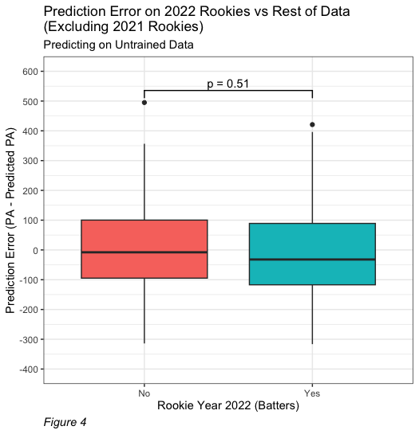
Batter Distribution
Batter Distribution
Notes:
Aidan

Slide 28
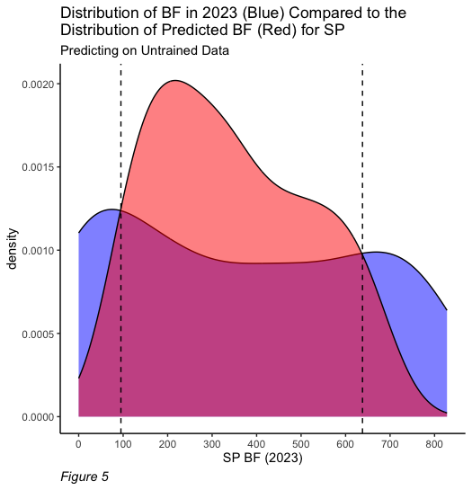
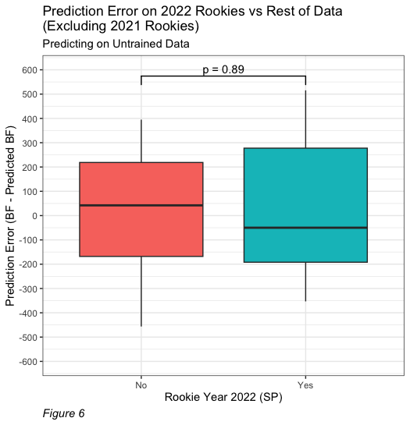
SP Distribution ➞ RMSE: 220.4
Notes:
Dylan
SP RMSE: 220.4
High due to the amount of Major SP Injuries that occur after the season that knocks out pitchers for the offseason

Slide 29
Batters Faced Outliers (2023)
Pitcher | 2021 BF | 2022 BF | 2023 BF
Pitcher 1 | 586 | 574 | 0
Pitcher 2 | 779 | 608 | 7
Pitcher 3 | 538 | 646 | 0
Pitcher 4 | 774 | 780 | 19
Notes:
Dylan

Slide 30
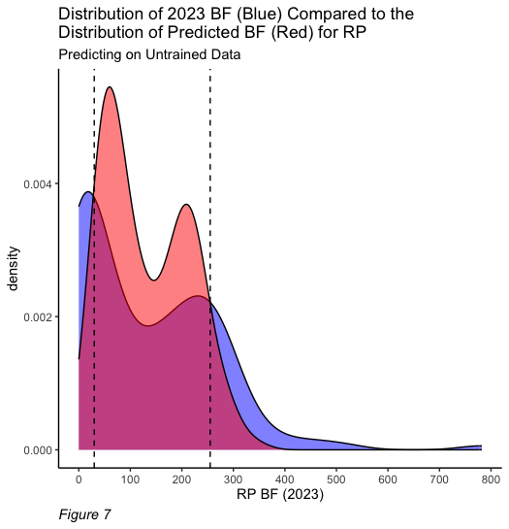
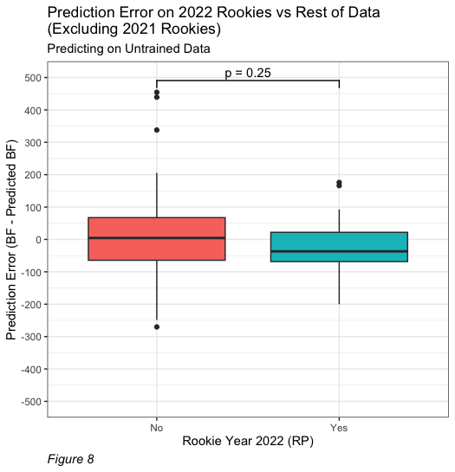
RP Distribution -> RMSE: 103.9
RP Distribution ➞ RMSE: 103.9
Notes:
Aidan
RP RMSE: 103.9

Slide 31
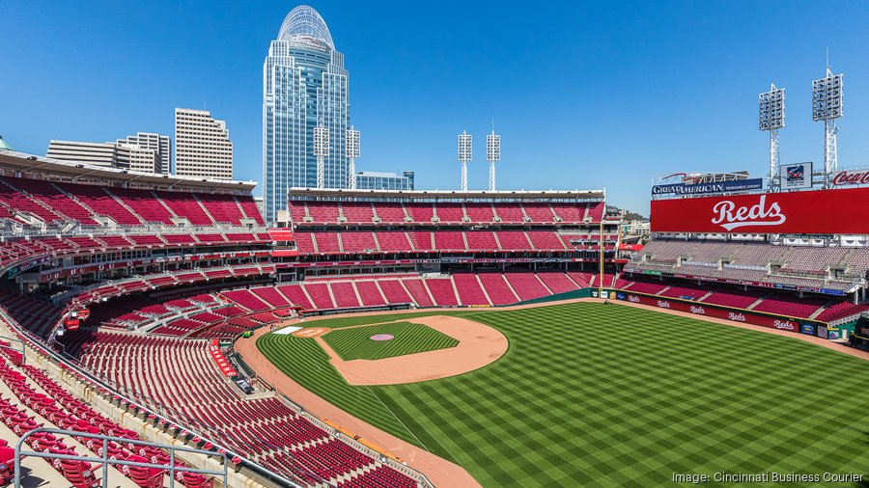
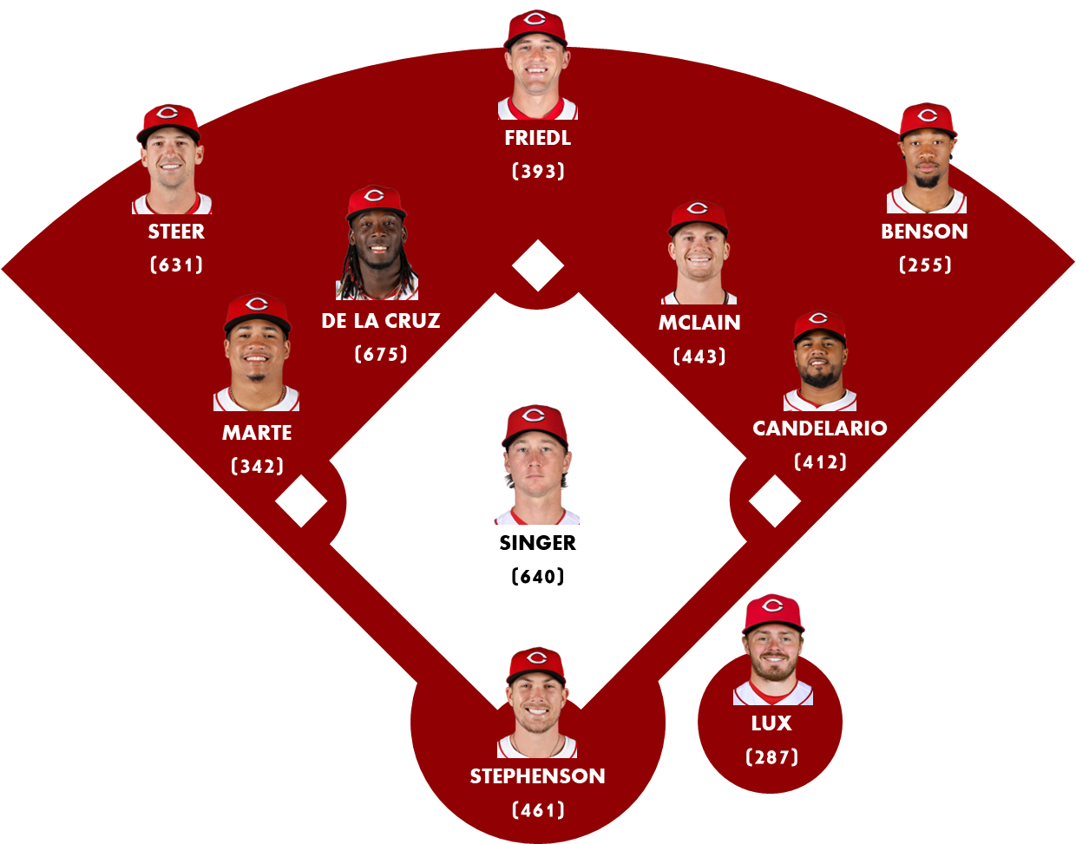
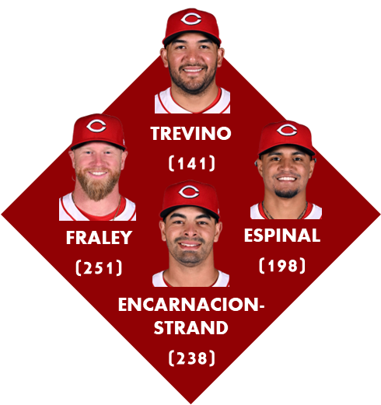
PREDICTED PLAYING TIME:
STARTING PITCHERS:
(640)
BRADY SINGER
(574)
Hunter GREENE
(394)
ANDREW ABBOTT
NICK LODOLO
(314)
(274)
RHETT LOWDER
RELIEF PITCHERS:
(357)
NICK MARTINEZ
(184)
Alexis Díaz
(189)
Scott barlow
Notes:
Brett

Slide 32
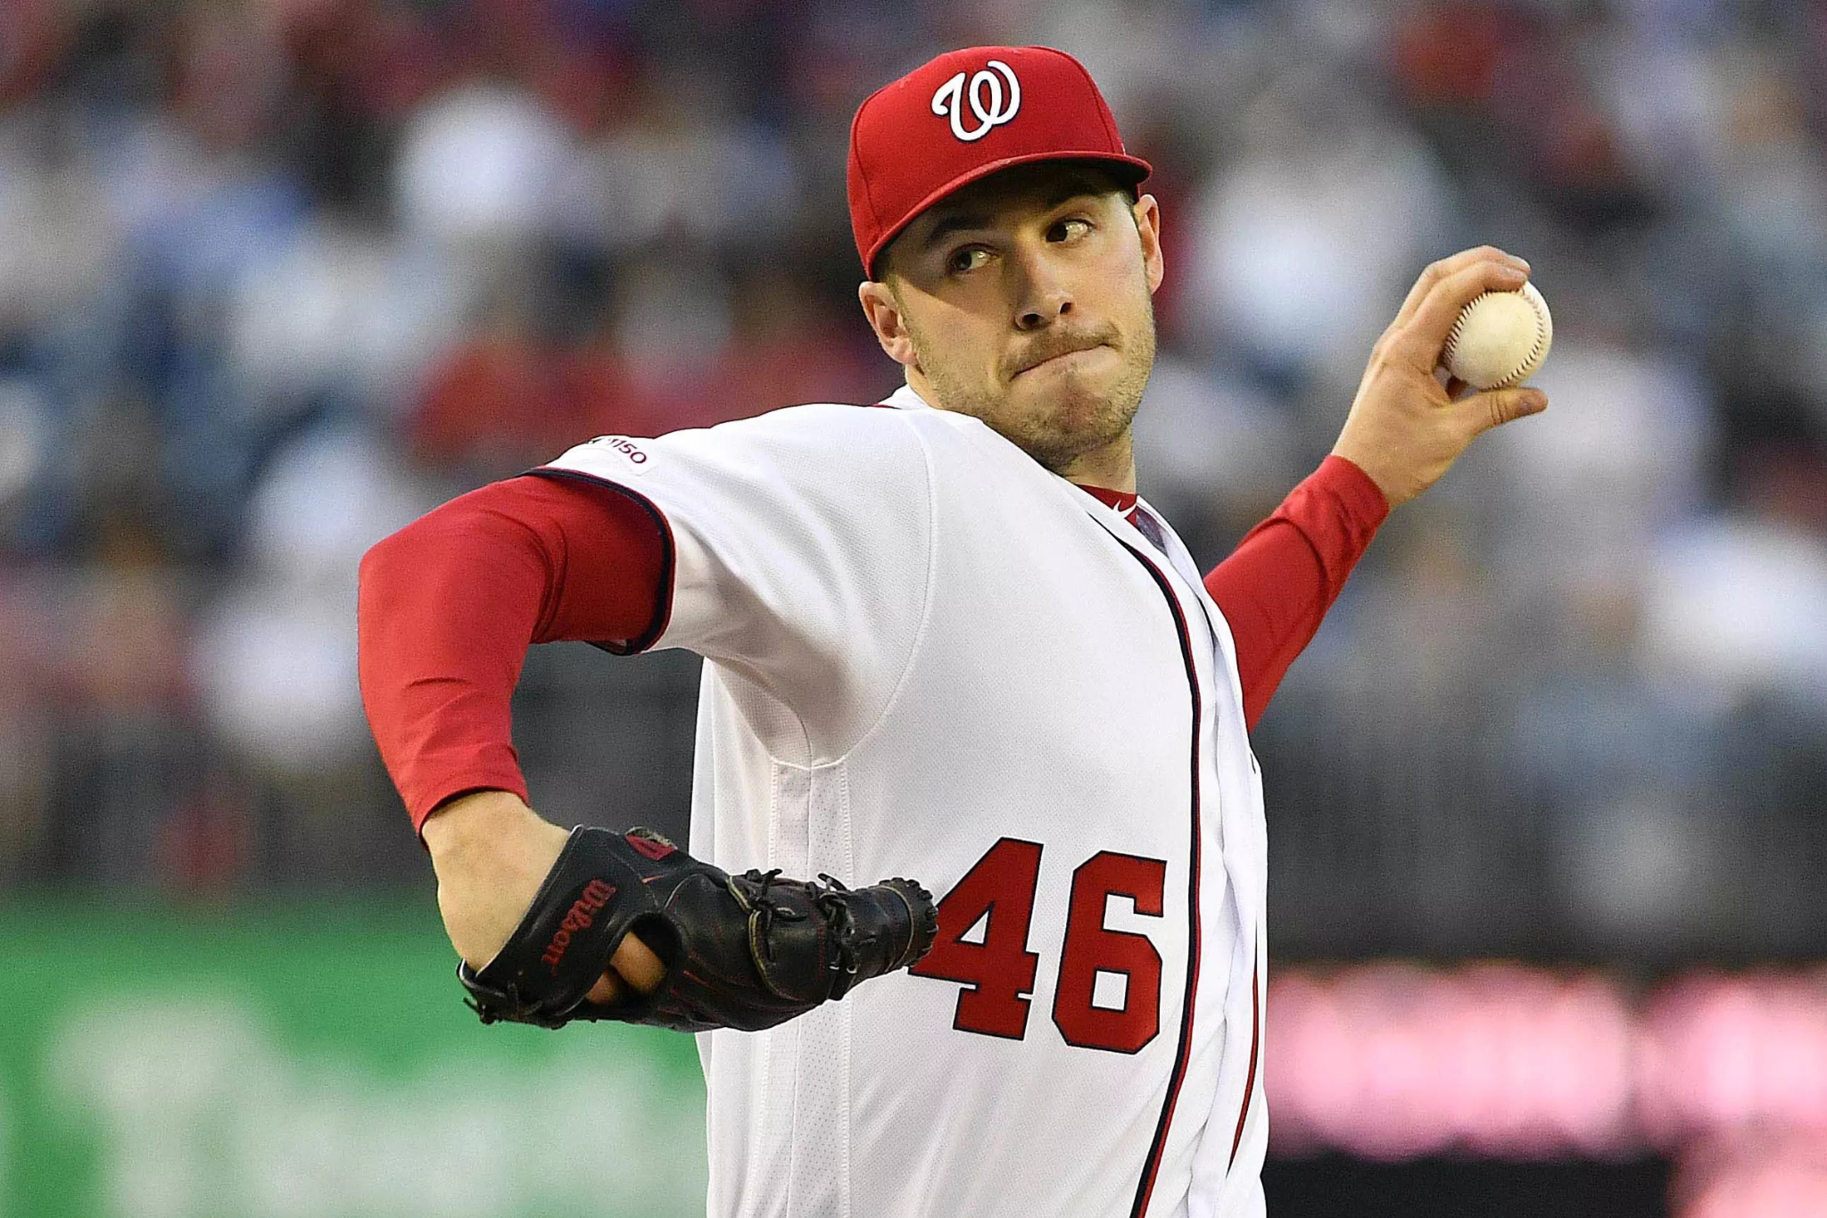
RMSE Evaluation
Limitations
Preseason and
Offseason Injuries
Lack of Information on Contracts and Service Time
Doesn’t Account for
Team Quality
Don’t Know Time Spent
on 26-Man Roster
Notes:
Danielle

Slide 33
Questions?

